Slide 1
STRESS & FATIGUE MANAGEMENT

Slide 2
STRESS
The word “stress” at workplace stress is most often confined or used to describe anxiety about deadlines. Work management is the key to this challenge. Stress at workplace is a product of subconscious beliefs one has about events around you. To destress, one must challenge these beliefs so that you see them differently.

Slide 5
RESPONSE TO STIMULI

Slide 6
INDIVIDUAL PERCEPTION TO STRESSORS

Slide 7
Behavioural Control

Slide 8
Individual Interactions

Slide 10
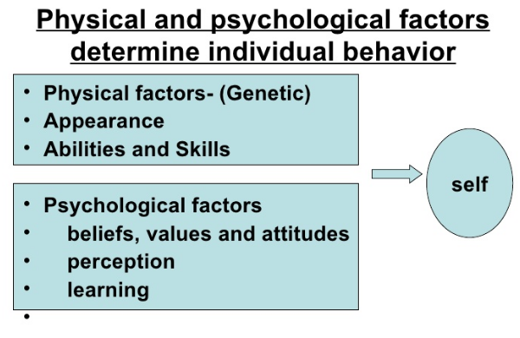

Slide 14
WORK PLACE STRESS

Slide 15
Cause of STRESS at work

Slide 16
Relationship between Work Pressure and Performance

Slide 18
Effect of stress on the individual
BODY
FATIGUE
MIND
IMPAIRED JUDJEMENT
EMOTIONS
DRINKING
BEHAVIOUR
IRRITABILITY
SICKNESS
HEADACHE
BREATHLESSNESS
MUSCULAR TWITCHES
HASTY DECISIONS
WORRYING
FUSSY
LACK OF CONFIDENCE
NEGATIVITY
SMOKING
INSOMNIA
LOSS OF APPETITE
INDECISIONS

Slide 19
Stress Management
Estimate how much time you're spending at work or occupied with work when you're not at your workplace.
Determine how much time you spend at work doing things that aren't necessarily constructive, such as social networking, talking to co-workers about unrelated topics, or writing personal emails.
Consider taking measures that would make your job less stressful, such as sharing tasks with others at work.
Learn to say no when you're already facing a full workload. .
Schedule family time each week.
Set aside time to do something you enjoy.
Exercise regularly. .

Slide 20
MASLOW’s THEORY

Slide 21
Individual’s goal

Slide 22
Individual’s goal

Slide 23
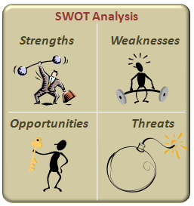

Slide 24
CHANGING DISTRESS TO EUSTRESS

Slide 25
EISENHOWER MATRIX

Slide 26
FATIGUE

Slide 27
• Tiredness is a state of the mind and/or body feeling the need for rest.
• Stress is the non specific reaction of the mind and/or body to any demand. Stressors can cause just about everything from a fleeting momentary reaction (startle response) to a heart attack.
• Fatigue is an extreme form of tiredness, often described as exhaustion. It can be acute or chronic.
• Burnout, which is now referred to as compassion fatigue, especially among stressed health care workers, such as those in military settings at time of war, is a chronic form of tiredness that can interfere with the ability to function.

Slide 28
What is Fatigue?
• Fatigue Is a Complex State Characterized by a Lack of Alertness and Reduced Mental and Physical Performance, Often Accompanied by Drowsiness
• Misconception: Fatigue Is Not Just Falling Asleep.

Slide 29
CAUSES OF FATIGUE
Physical Load
Forceful Exertion
Awkward Posture
Statcic Load
RepititiveMovement
Mental Load
Environmental Load
Irregular work hours
Job demands
Job aStress
Coworker relationship
Decision autonomy
Temperature
Noise
Light Level
Vibration
Humidity

Slide 30
Factors That Affect Fatigue
• Time of Day/Circadian Effects
• Sleep Disorders
• Environmental Conditions
• Nutrition
• Physical Fitness
• Drugs
• Health
• Age.

Slide 31
Effects of Fatigue
Reduced ability to:
•concentrate and avoid distraction
•think laterally and analytically
•make decisions
•remember and recall events and their sequences
•maintain vigilance
•control emotions
•appreciate complex situations
•recognise risks
•coordinate hand-eye movements, and
•communicate effectively.

Slide 32
Fatigue Signs and Symptoms
• Forgetfulness
• Poor Communication
• Impaired Decision - Making Skills
• Lack of Alertness
• Slow Reaction Time
• Microsleep.

Slide 33
Mental Fatigue
• Tired and Drowsy Due to Loss of Sleep
• Loss of Concentration And/Or Alertness
• Diminished Levels of Creativity and Logic.

Slide 34
Physical Fatigue
• A Decrease in Physical Performance
• A Feeling of Muscle Discomfort or Soreness
• Lack of Energy.

Slide 35
Long term health effects of fatigue
• Heart disease
• Diabetes
• High blood pressure
• Lower fertility
• Anxiety
• depression
• Gastrointestinal disorders

Slide 36
Why is Fatigue a problem?
• Increases chance of workplace injuries
• Prevents a person from performing work safely
• Increases error rates
• Increases risk taking behaviour
• Decreases work efficiency
• Decreases motivation
• Cause micro-sleeps

Slide 37
Risk Factors
Work Related
•Roster patterns
•Length of shifts
•Poor work scheduling and planning
•Timing of shifts e.g. night shift •Insufficient recovery between shifts
•Long periods of time awake •Mentally of physically draining work
•Inadequate rest breaks
Individual/Lifestyle
•Sleep loss and/or disruption of internal body clock
•Poor quality of sleep •Sleeping disorders
•Travel time
•Family needs
•Sporting commitments •Social life
•A second job
•Alcohol and/or drug abuse
•Stress caused my factors outside of work

Slide 38
WHAT ARE UNUSUAL WORK SCHEDULES?
• Anything other than M-F Day Shift, 40 hours per week.
• Night work (during hours normally reserved for sleep).
• Rotating shift work.
• Extended work day schedules (regular 10- or 12-hour shifts). Based on 40-hour week.
• Extended workweek schedules (regular 50- to 80-hour workweeks).

Slide 39
WORK SCHEDULE
Rotations
Hours
Off Days
JOB LIFE
Mood
Health
Safety Productivity
HOME LIFE Eating Sleeping Family Recreation

Slide 40
WORK SAFETY RESEARCH
FATIGUE
ERRORS
ACCIDENTS
INJURIES
FATALITIES
Shiftwork,
Extended Workday
Schedules

Slide 41
ACCIDENT CAUSATION MODEL
Boredom?
Worries?
Illness?
Lack of sleep?
Shift work?
Vibration?
FATIGUE
INATTENTIVENESS (42%-
UNALERTNESS 56%)
Noise?
Alcohol?
Age?
Drugs?
HUMAN ERROR (85%)
ACCIDENTS

Slide 42
Keys to Change
• Knowledge of Fatigu
• Awareness of Fatigue’s Effect on Safe Operations
• Understanding of Your Workplace Safety Culture.

Slide 43
What to look for in your work- colleagues
• Constant yawning
• Falling asleep at work
• Short term memory problems
• Inability to concentrate
• Difficulty engaging in effective communication
• Impaired decision making and judgement
• Reduced hand-eye coordination or slow reflexes

Slide 44
Fatigue prevention
• SLEEP!
• Schedule rest breaks. Don’t work through lunch!
• Exercise. Yes, that’s right- EXERCISE!
• Eating healthy
• Drinking water
• Avoid binge drinking
• Limit working excessive hours, avoid split shifts and last minute roster changes.

Slide 45
By preventing fatigue in the workplace you…..
• Will have better health and safety outcomes
• Reduce workplace incidents and injuries
• Reduce levels in absenteeism and staff turnover.
• Increase level of performance and productivity.

Slide 46
Strive for Perfection
Settle for Excellence

